Slide 1
Competitor Analysis: Swiggy vs. Zomato
Dominating India's Food & Quick Commerce Landscape

Slide 2
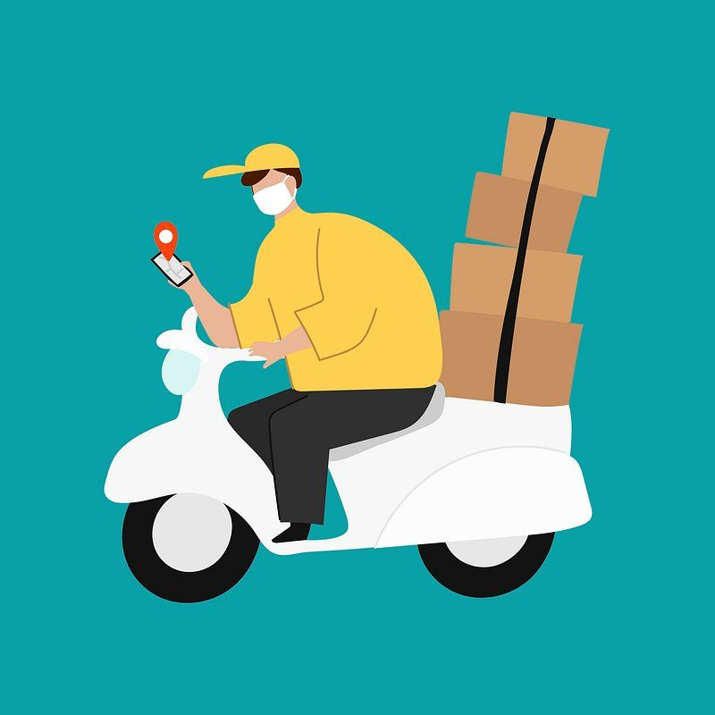
SUMMARY
Swiggy and Zomato Indians face-to-head for leadership in Indian fast trade and food distribution industry. Although he improved the opponent in the financial calculations for Zomato FY25, despite reporting the profits and increased revenue, SWIGGY has chosen to expand the difference in the rapid commercial segment, Insta-mart, who claims strong user engagement. Both companies utilize sophisticated digital marketing, mobile, SEO, paid ads and social media, which correspond to their most important strength and strategic priorities. The both players are important trends to see increasing focus on profitability.

Slide 3
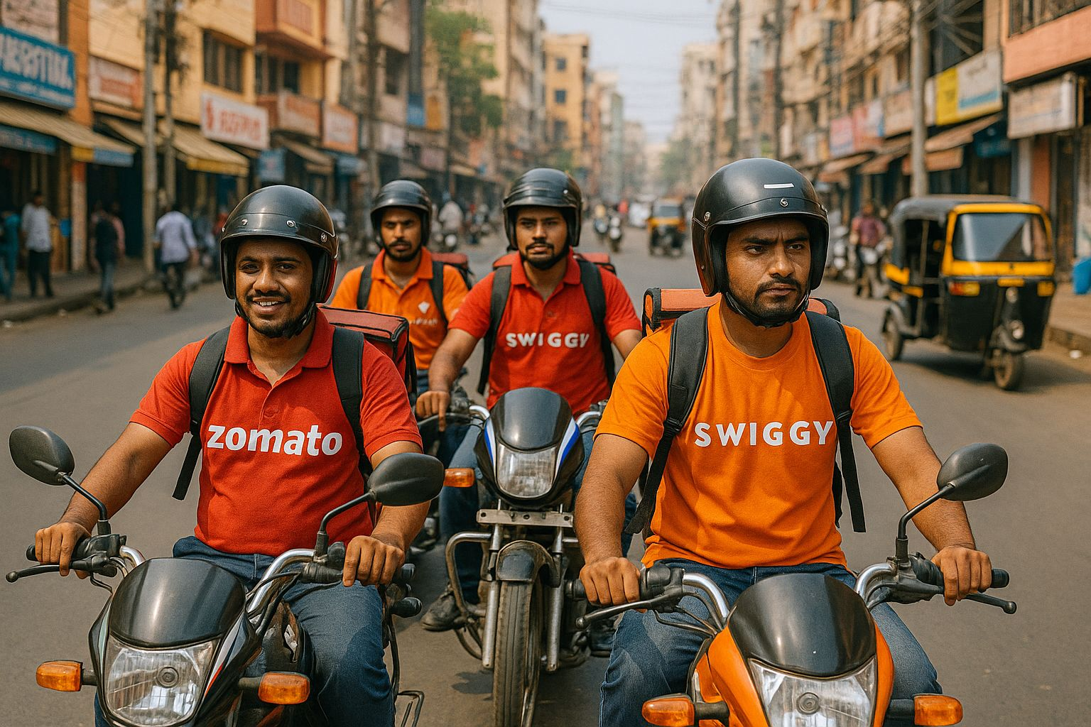
Introduction - Fight for Dominance
The Indian food delivery market: A hard competitive sector, which was estimated at $ 55 billion.
The players: Swiggy and Zomato Titans, save together 90% market degree.
Our goal: To benchmarking their digital appearance and techniques, both their strength, weaknesses and luck in the projections and in both food-ships and burning short shopping quarters.

Slide 4
Market Snapshot & Financial Health
Zomato: Leading the Pack
Swiggy: Expanding Rapidly
Revenue: ₹20,243 crore (↑ 67% YoY)
Profitability: Achieved net profitability, a significant milestone.
Food Delivery Customers: 2.09 crore avg. monthly.
Quick Commerce (Blink-it):
Orders: 15.7 lakh daily orders.
Dark Stores: 1,301.
Performance: Strong lead in daily orders, reducing losses, moving towards profitability.
Investor Confidence: Trading at a higher Price-to-Sales ratio (12.2x), Signaling strong investor trust.
Market Share: Estimated 55-58% in food delivery.
Revenue: ₹15,227 crore (↑ 35% YoY)
Profitability: Net loss widened to ₹3,117 crore.
Food Delivery Customers: 1.51 crore avg. monthly.
Quick Commerce (Insta-mart):
Orders: 12-15 lakh daily orders.
Dark Stores: 1,021.
Performance: Rapid expansion (100 new cities, 498 new dark stores in FY25), showing "early profitability" in key markets.
Strategic Growth: Added 2,000 employees in FY25, primarily for Insta-mart.

Slide 5

Digital Presence - Traffic & Engagement
Website Traffic (Monthly Visits):
Swiggy.com: 17.2 Million
Zomato.com: 16 Million
Insight: Swiggy slightly leads in website visits.
Engagement Metrics (Website):
Avg. Visit Duration: Swiggy (00:08:24) > Zomato (00:05:51)
Pages per Visit: Swiggy (6.24) > Zomato (3.86)
Bounce Rate: Swiggy (37.24%) ≈ Zomato (37.03%)
Insight: Swiggy shows higher website engagement, with users spending more time and exploring more pages.
App Dominance: Both platforms see the majority of their engagement and orders via their mobile apps. Zomato historically shows better app install penetration.
Geo-targeting: Both excel in hyperlocal content and promotions, critical for their business model.

Slide 6
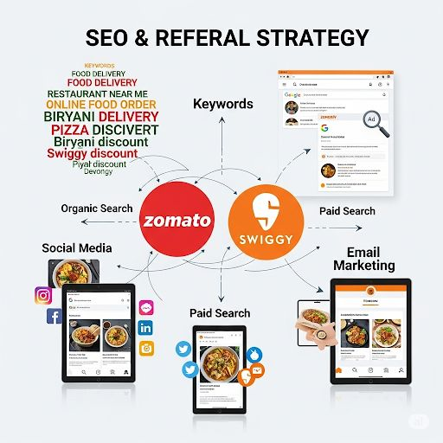
Digital Presence - SEO & Referral Strategy
Top Keywords & SEO
Zomato's Strength: Dominant in organic search. Ranks for broad terms like "restaurant," "cafes," "best food," and specific cuisine/location searches. High Domain Authority (DR 88) due to extensive restaurant listings and content.
Swiggy's Strength: Strong for branded terms ("Swiggy," "Instamart") and transactional keywords like "order food online," "food online order near me." Focus on instant delivery.
Insight: Zomato's comprehensive content gives it an edge in discovery SEO, while Swiggy's SEO is highly optimized for direct conversions.
Referral Sources & Paid Marketing
Direct Traffic: High for both, indicating strong brand recall and habit.
Organic Search: A significant driver, especially for Zomato.
Paid Search (PPC):
Swiggy: Higher investment in aggressive paid search and display ads for user acquisition and promotions.
Zomato: Strategic use of paid ads, often for hot leads and specific quick commerce USPs (e.g., Blinkit 10-minute delivery).
Social & Email: Both effectively use social media for brand building and email/push notifications for personalized offers and retention.

Slide 7
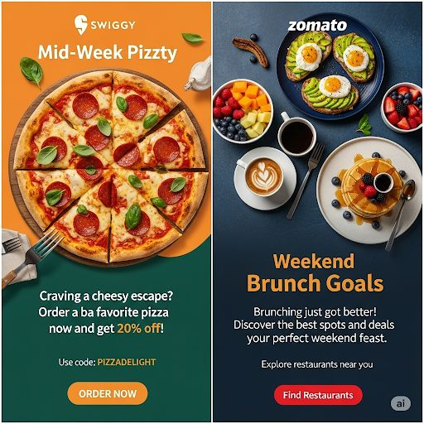
Digital Presence - Social Media & Content
Zomato: The Witty Creator:
Strategy: Meme-driven, influencer collaborations (e.g., IPL).
Impact: #ZomatoMemes achieve massive virality.
Swiggy: The Relatable Foodie:
Strategy: Food humour, contests, Instamart promotions.
Impact: Resonates with everyday food experiences.

Slide 8
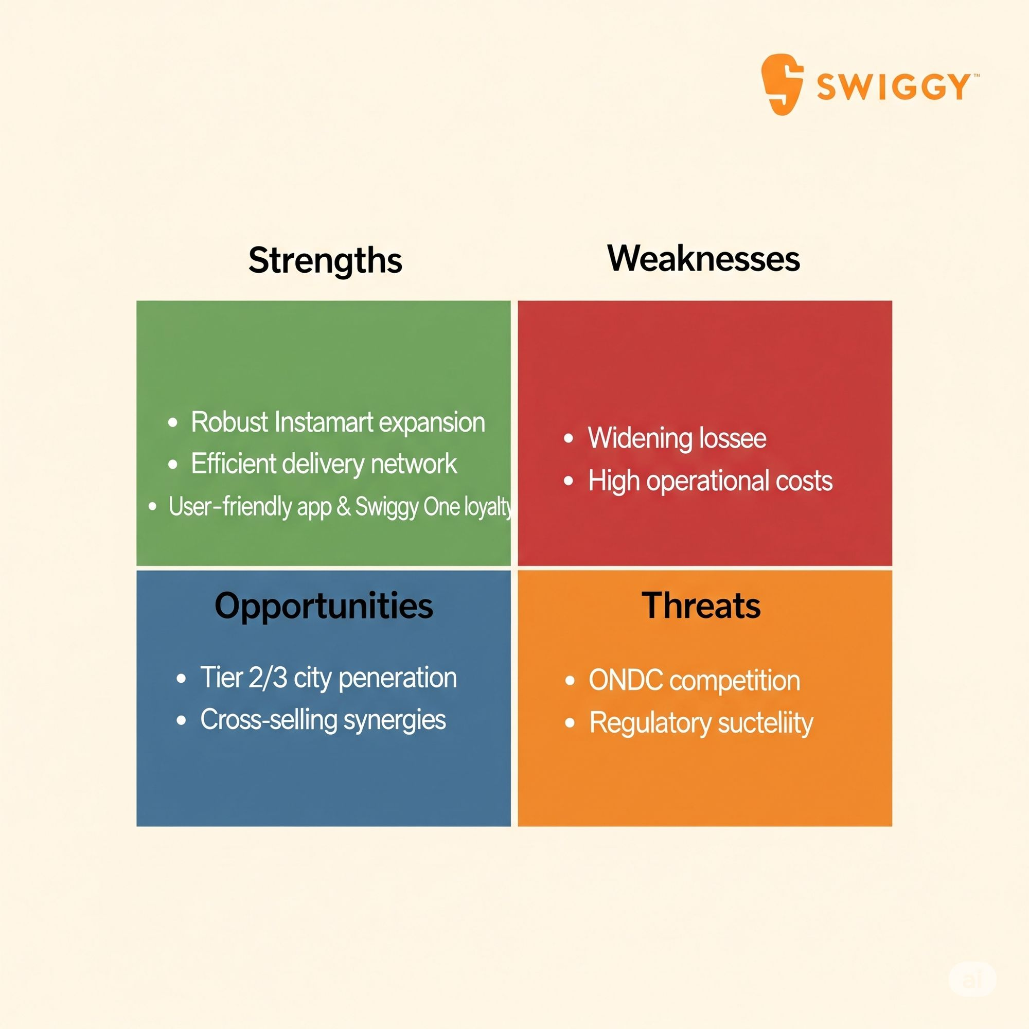
SWOT Analysis - Swiggy
Strengths:
Robust Instamart expansion.
Efficient delivery network.
User-friendly app & Swiggy One loyalty.
Weaknesses:
Widening losses.
High operational costs.
Opportunities:
Tier 2/3 city penetration.
Cross-selling synergies.
Threats:
ONDC competition.
Regulatory scrutiny.

Slide 9
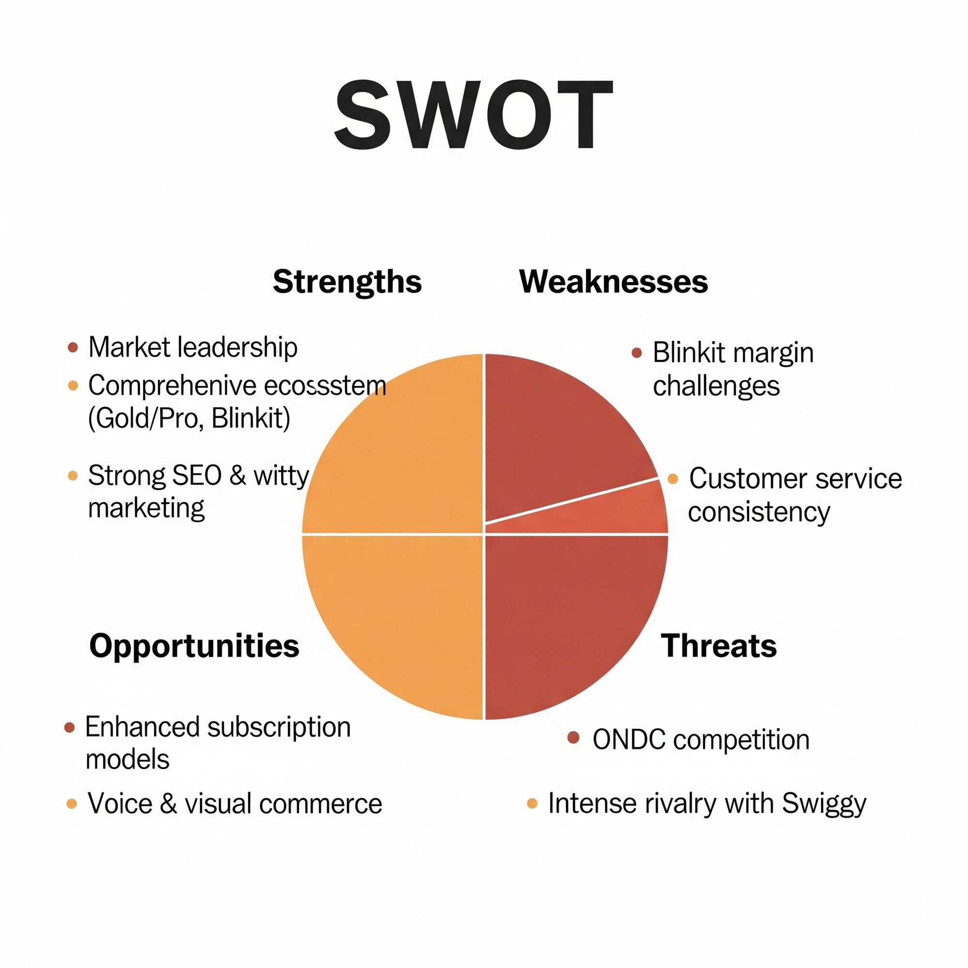
SWOT Analysis - Zomato
Strengths:
Market leadership.
Comprehensive ecosystem (Gold/Pro, Blinkit).
Strong SEO & witty marketing.
Weaknesses:
Blinkit margin challenges.
Customer service consistency.
Opportunities:
Enhanced subscription models.
Voice & visual commerce.
Threats:
ONDC competition.
Intense rivalry with Swiggy.

Slide 10
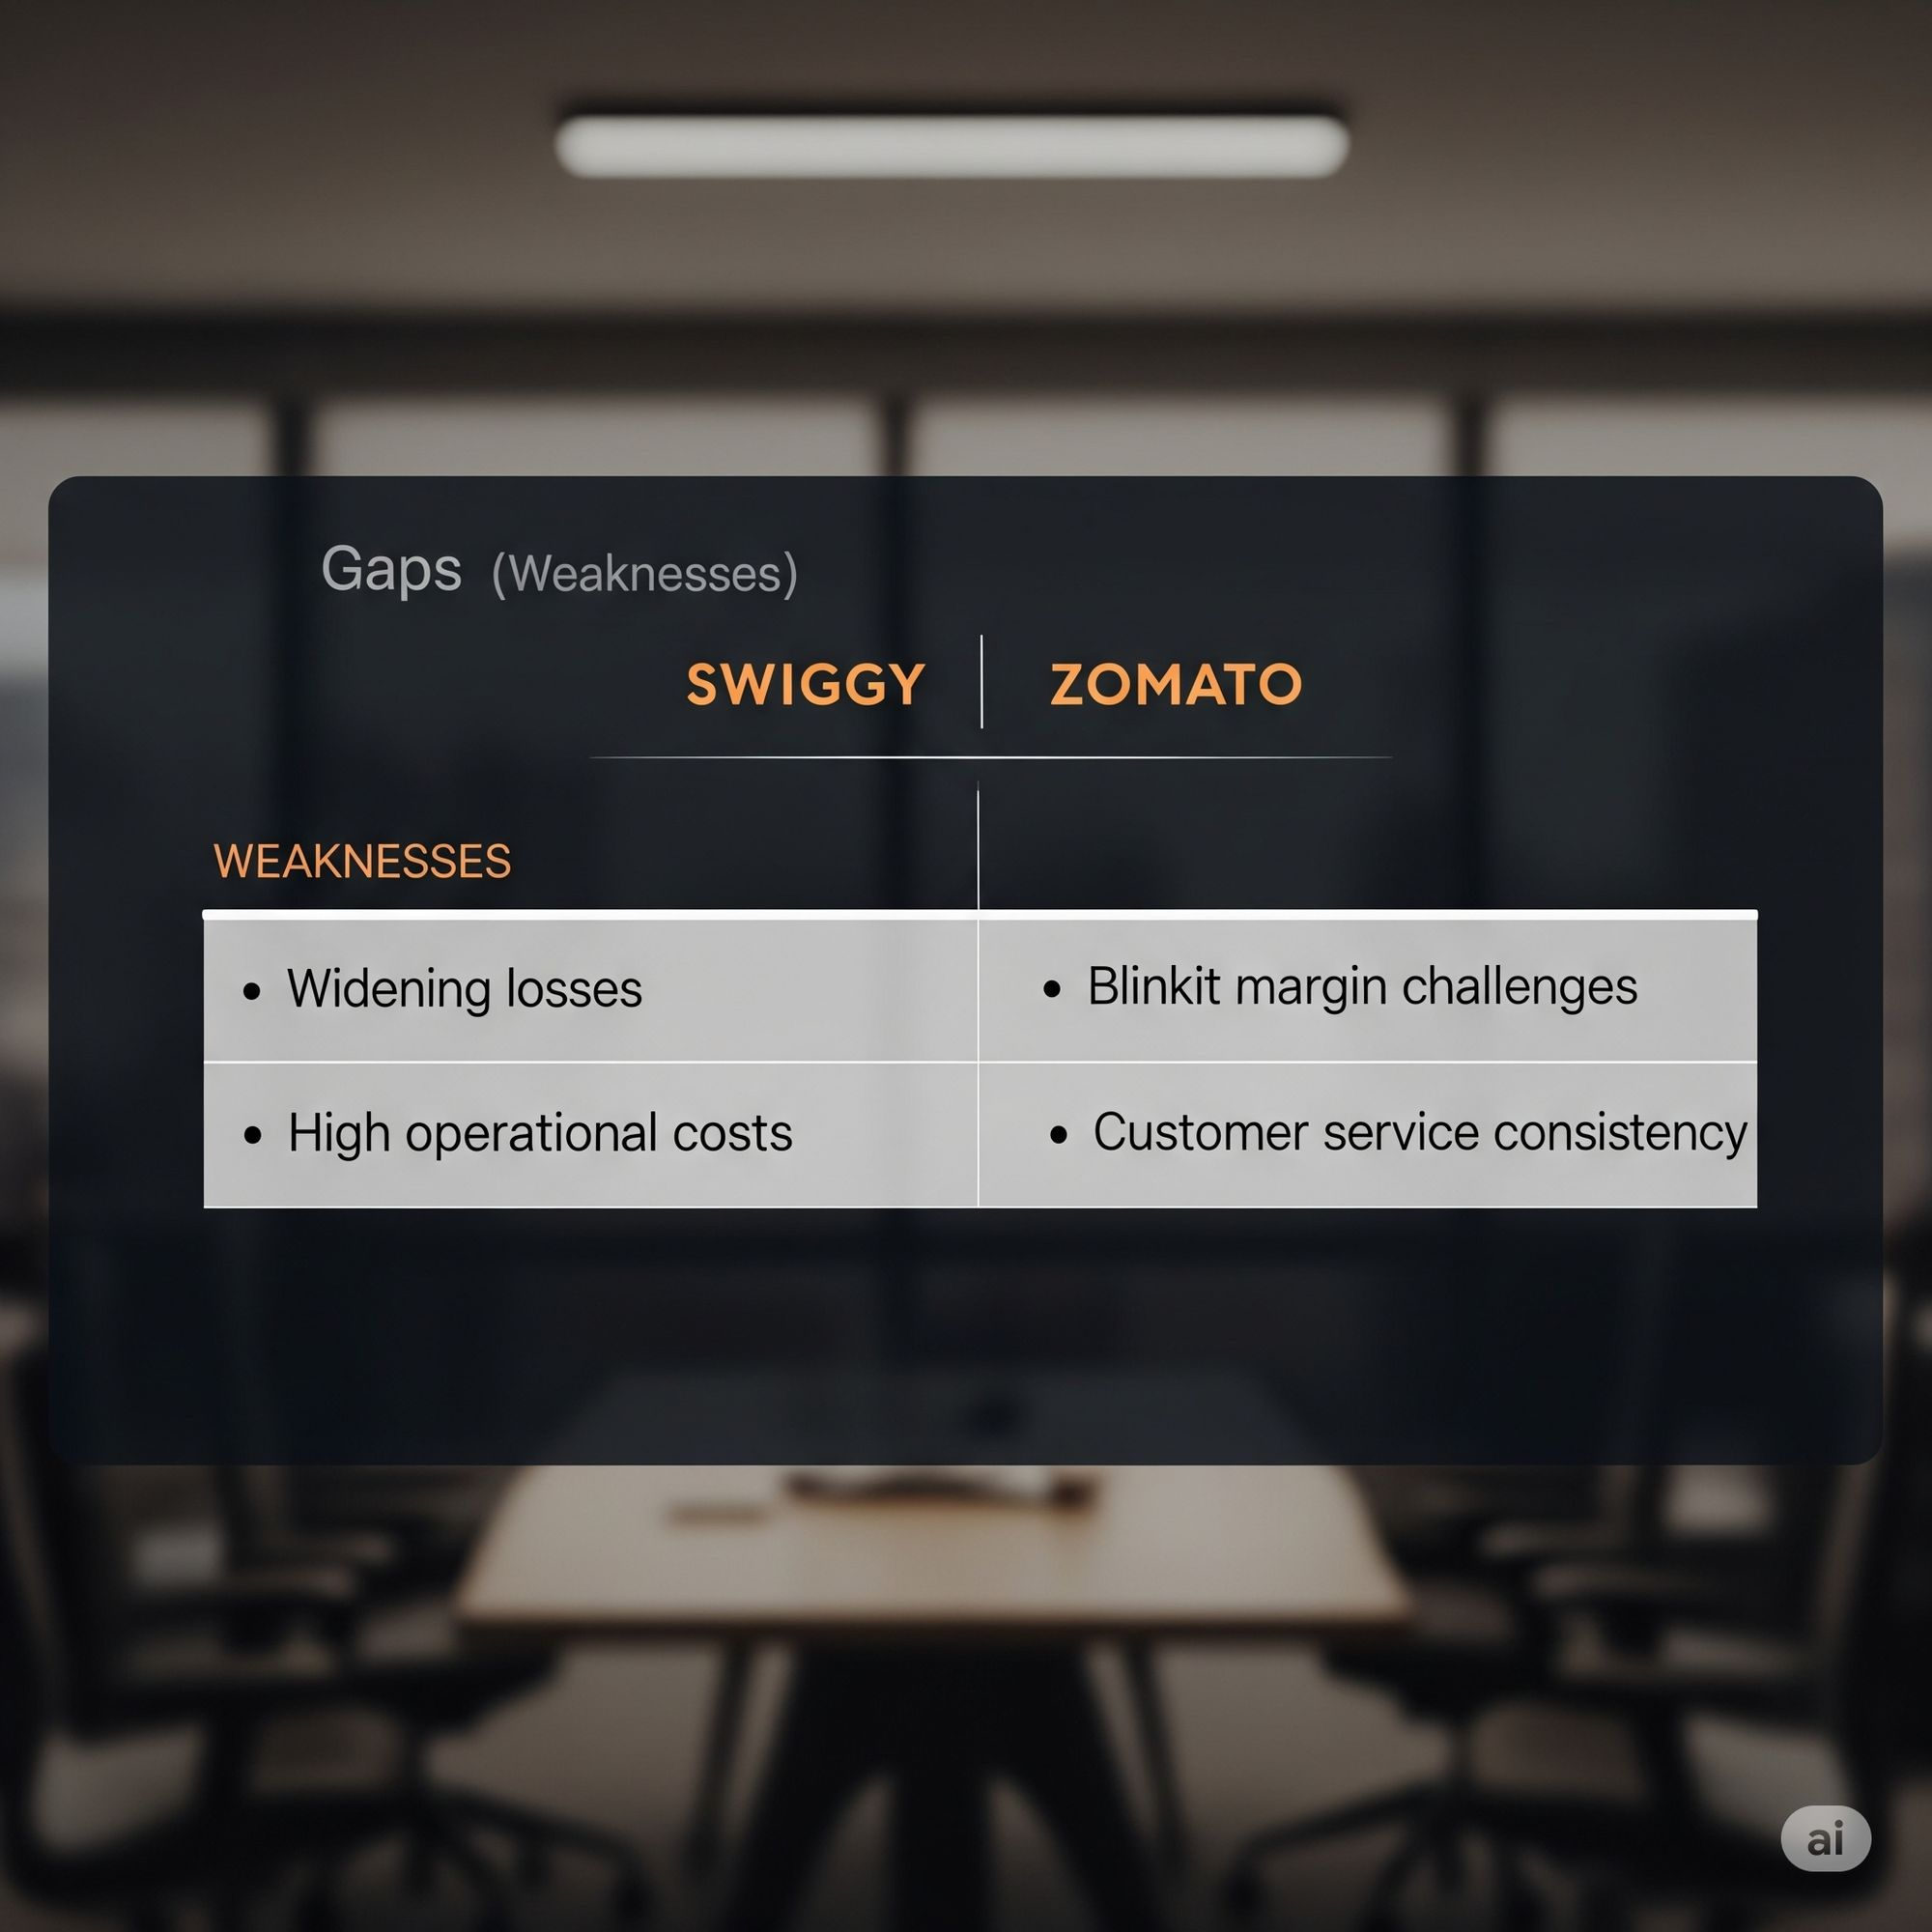
KEY GAPS
Swiggy:
Profitability challenges.
Weaker restaurant discovery SEO.
Limited dine-out presence.
Zomato:
Blinkit profitability.
Delivery speed perception.
Managing diversification.

Slide 11
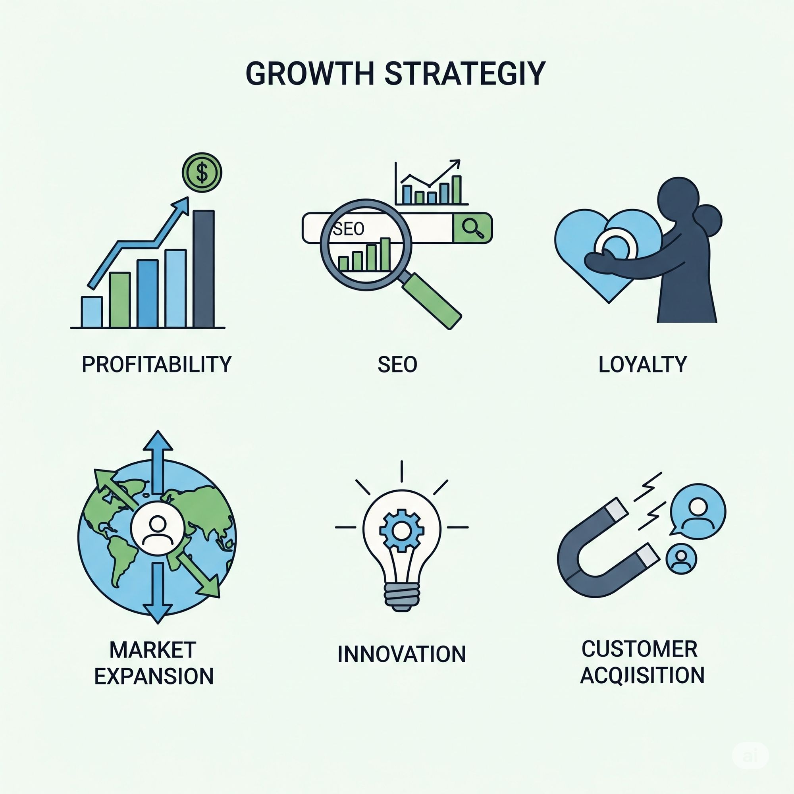
Recommendations
For Swiggy:
Optimize Instamart for profitability.
Enhance cross-selling via personalized promotions.
Boost discovery SEO.
For Zomato:
Improve Blinkit unit economics.
Highlight delivery speed in campaigns.
Innovate loyalty programs.

Slide 12
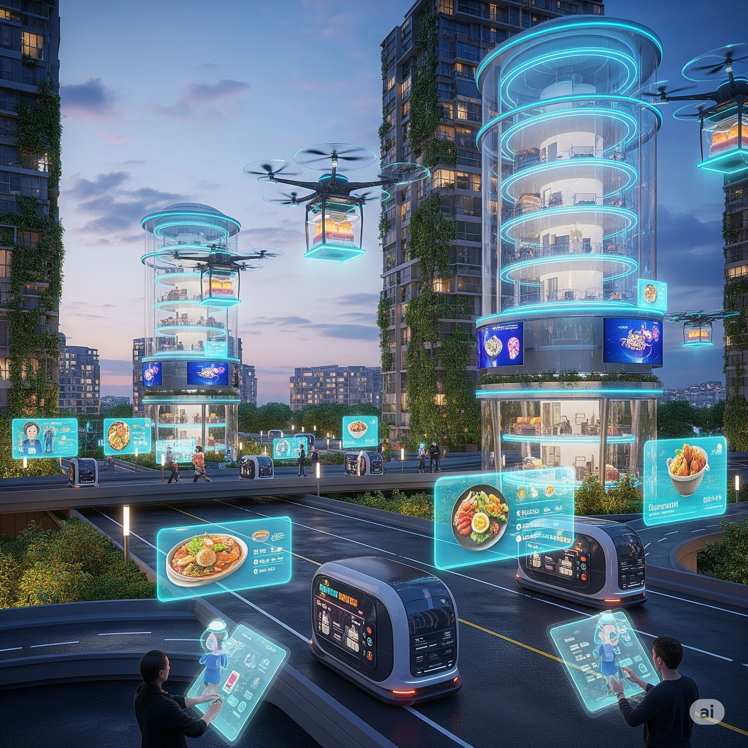
Conclusion
Both are formidable, with distinct digital strengths.
Success hinges on operational efficiency and seamless UX.
ONDC is a new competitive frontier.

Slide 13

Presented By :
Name: Madithati Purushotham Sai
Roll No: 2311res31
Mail: madithati_2311res31@iitp.ac.in

